Slide 1
Algorithmic Fairness in Cardiovascular Precision Medicine

Slide 2
What is algorithmic fairness
Algorithms are increasingly used to make decisions
Algorithms are not perfect – they can lead to biased decisions
Fairness aims to acknowledge and reduce potential sources of bias
Reduces the impact of negatively affecting members of a certain class

Slide 3
Sources of Unfairness
Bias within the training dataset
  Training dataset has a large proportion of a certain class and underrepresents other classes
Missing data
Algorithm Selection
  Algorithm aims to minimise overall prediction error, so benefits majority groups over minority

Slide 4
Aims
Build a machine learning model to predict cardiovascular disease outcome (using Gensini Index as a binary classifier)
Assess the fairness of the model and implement methods to improve fairness of the model

Slide 5
Common Fairness Metrics
Accuracy Parity: Checks if accuracy of algorithm is equal across different classes of sensitive attribute
Equalized odds: Checks if algorithm predict a particular label (i.e. disease presence) equally well for all values of sensitive attribute
Demographic Parity: Checks if models classifications (i.e. disease presence) are independent of sensitive attribute

Slide 6
Common Fairness Metrics
Accuracy Parity: Checks if accuracy of algorithm is equal across different classes of sensitive attribute
Equalized odds: Checks if algorithm predict a particular label (i.e. disease presence) equally well for all values of sensitive attribute
Demographic Parity: Checks if models classifications (i.e. disease presence) are independent of sensitive attribute

Slide 7
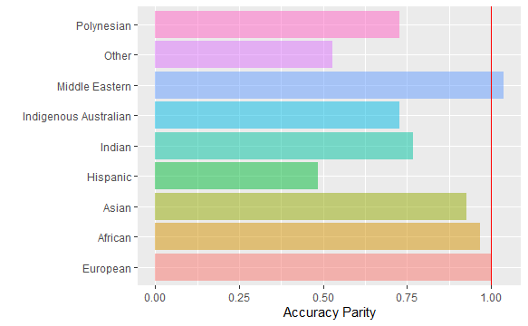
Accuracy parity plot of logistic regression

Slide 8
Enhancing Fairness of Algorithm
Pre-Process
  Change the training data BEFORE feeding into algorithm
  E.g. Reweighting of data
    Assigning weights to each subgroup in each class (i.e. different weights for each ethnicity + disease outcome combination)
Post-process
  Processing output score of classifier
  E.g. Reject Option Based classification (ROC classification)
    Changes classification of disease outcome
    1. When unprivileged subgroup is within (0.4, 0.5) then 0 → 1
    2. When privileged subgroup is within (0.5, 0.6) then 1 → 0

Slide 9
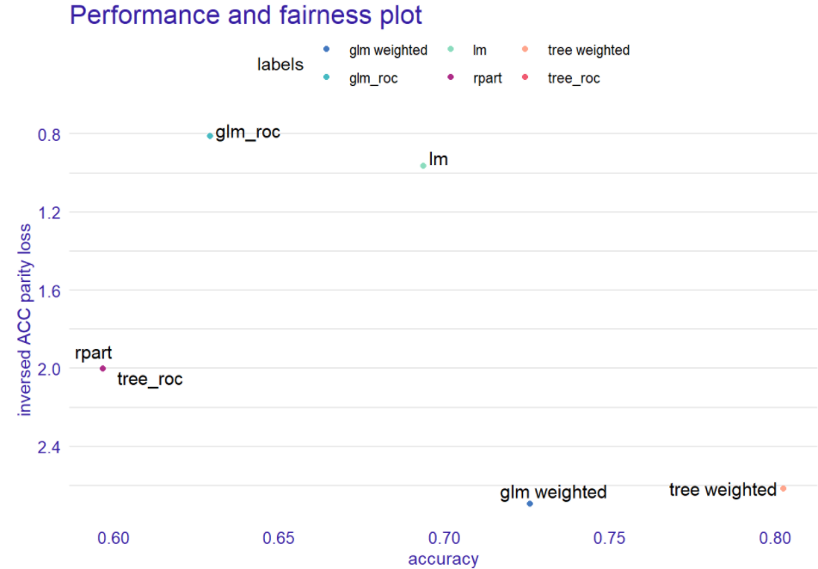
Overall data

Slide 10
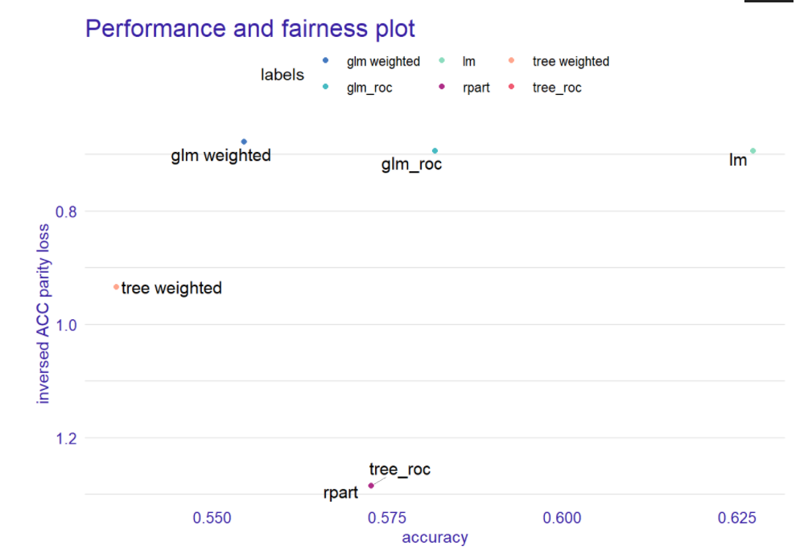
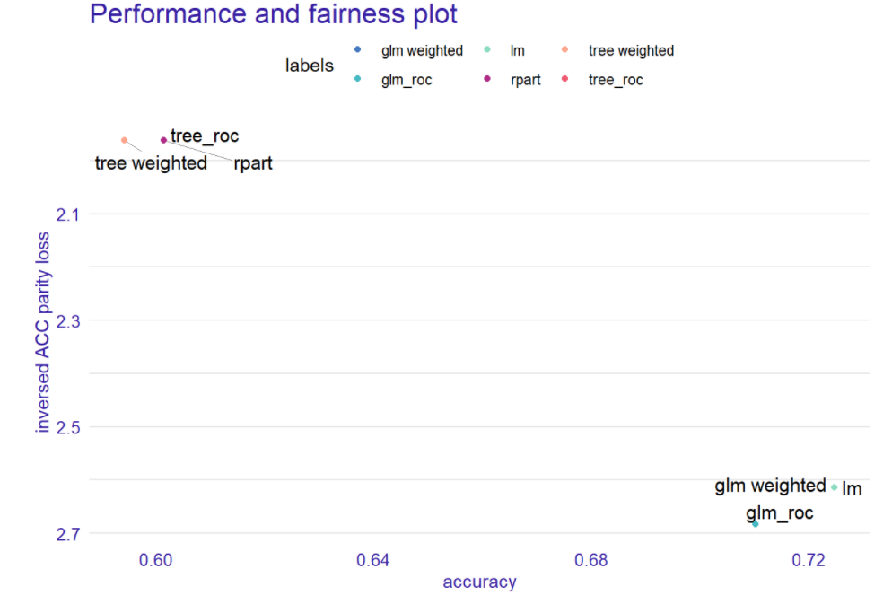
Female data
Male data

Slide 11
Possible applications
Using ‘fairness’ criteria to assess bias within datasets
Minimizing bias using processing algorithms

Slide 12
Future directions
Train other classification models and tune models to improve accuracy of the base model
  Rigorous feature selection
  Possibly using dimension reduction to minimize features
Assess fairness criteria on tuned models and analyze the impact on accuracy of processing algorithms

